Slide 1
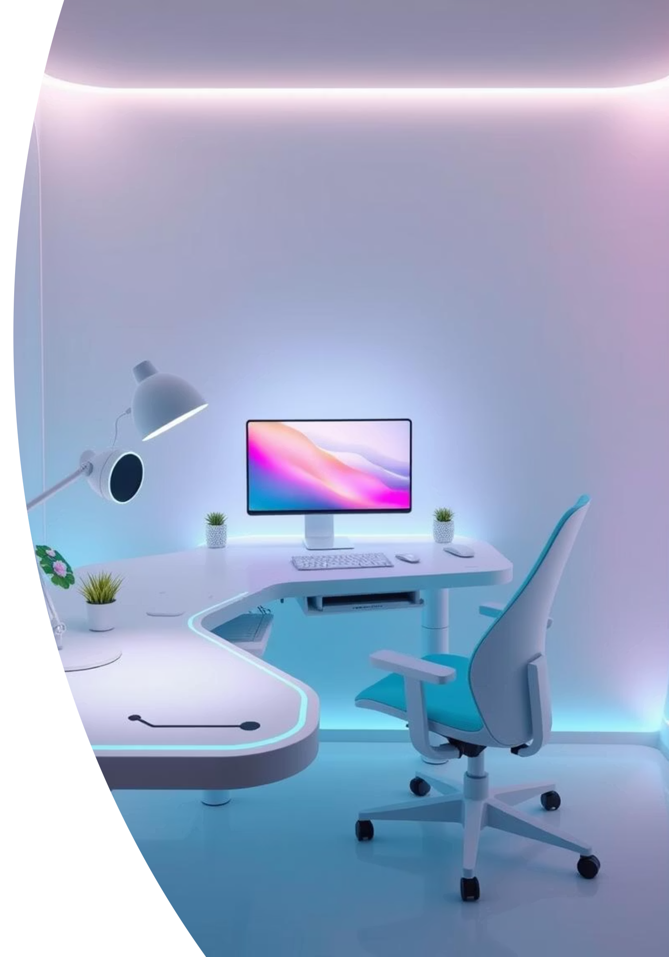
Ohmies: Revolutionizing Posture Health
Welcome to the Ohmies presentation for the IEEE-VIT Hackathon. We're here to introduce a revolutionary device designed to transform how we approach posture health. Our solution combines advanced technology with user-centric design to provide real-time feedback and long-term improvement.

Slide 2

Meet the Ohmies Team
SC Sooryakanth Ramakrishnan
Responsible for software development, BLE integration, and 3D modeling. Sooryakanth's expertise ensures seamless data flow and a robust device structure.
Antara Prabhune
Focuses on UI/UX design, R&D, and hardware implementation. Antara ensures the Ohmies app is intuitive and the device is physically sound.
Aarnav Rao
Handles sensor integration, documentation, and additional R&D. Aarnav's precision with sensor data is crucial for accurate posture tracking.

Slide 3

Introducing Ohmies: Smart Posture Correction
Ohmies is a smart posture tracking, monitoring, and improving device. It uses advanced sensors to detect your posture in real-time, providing instantaneous feedback to help you correct it. Beyond mere detection, Ohmies systematically stores your posture data, allowing for long-term monitoring and personalized improvement plans through its companion app.

Slide 4

Analyzing the Competitive Landscape
Upright Go2
Strack
A popular wearable that vibrates when you slouch. While effective for immediate feedback, it lacks comprehensive long-term data analysis and personalized improvement programs.
Offers real-time posture monitoring and analysis. However, it often relies heavily on vibration feedback and may not provide the detailed visual insights or custom alerts that Ohmies does.
Hipee P1
Features smart reminders and posture tracking. Its drawback lies in less precise angle detection and a more generalized feedback system compared to Ohmies' nuanced approach to posture categorization.
Our research into existing posture devices like Upright Go2, Strack, and Hipee P1 revealed a market need for a more integrated and detailed solution. While these products offer basic posture correction, Ohmies aims to surpass them by providing comprehensive data, intuitive feedback, and a personalized improvement journey.

Slide 5





How Ohmies Works: A Seamless Experience
Posture Detection
Integrated IMU and flex sensors precisely track your spine's alignment and movement.
Data Transmission
ESP32 and BLE facilitate seamless transfer of posture data to your smartphone.
Haptic Feedback
A buzzer and LED provide immediate, discreet alerts for poor posture.
Data Analysis & App Integration
Posture data is systematically categorized (good, moderately bad, bad, very bad) and stored in the app for analysis and personalized plans.

Slide 6
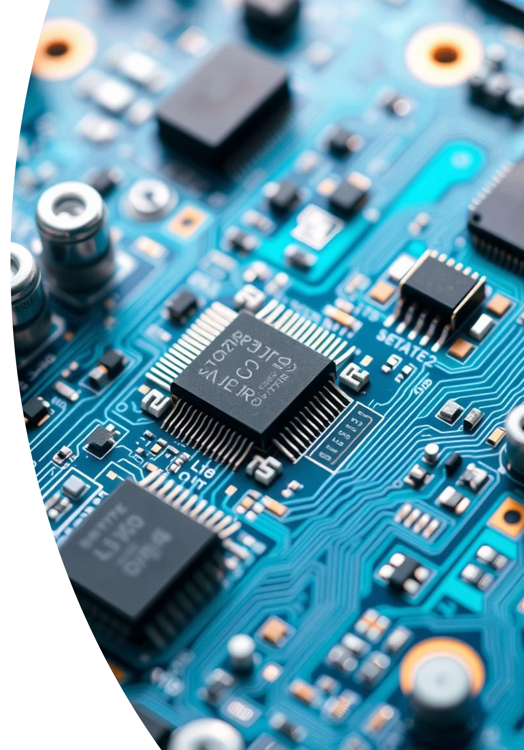
Preliminary Implementation Approach
Our initial implementation strategy for Ohmies focuses on a modular design. The hardware will involve strategically placed IMU (Inertial Measurement Unit) and flex sensors to capture nuanced spinal movements. The ESP32 microcontroller will serve as the core processing unit, handling sensor data and managing Bluetooth Low Energy (BLE) communication. For haptic feedback, a small, low-power buzzer and an LED will be integrated directly into the device.
On the software front, we will develop firmware for the ESP32 to process sensor inputs and classify posture based on predefined angle thresholds: 20-30 degrees of slouching for "moderately bad," 30-40 degrees for "bad," and 40+ degrees for "very bad." The mobile application will be built to receive this data via BLE, visualize posture trends, and provide actionable insights for users to improve.

Slide 7
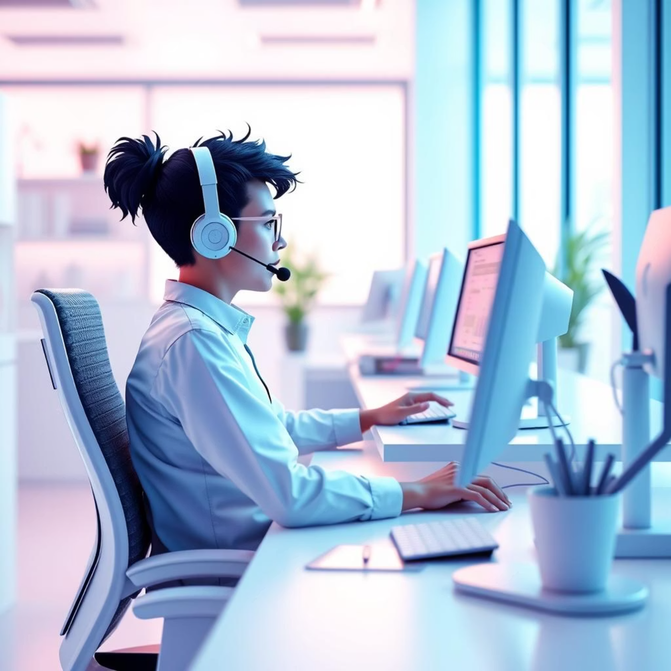
Expected Usage and Target Market
Ohmies is designed for daily use, seamlessly integrating into various lifestyles. We envision it being used by office workers spending long hours at desks, students studying for extended periods, and even gamers who often neglect their posture. The device provides subtle reminders, while the app offers detailed reports and guided exercises.
Our primary target market includes young professionals and students aged 18-35 who are increasingly aware of ergonomic health. We also aim to reach individuals who spend significant time using digital devices, as well as fitness enthusiasts looking to optimize their body alignment.

Slide 8

Addressing Current Model Drawbacks
Existing posture devices often fall short in comprehensive feedback and long-term engagement. Many provide only a simple "good" or "bad" indication, lacking the granular detail needed for effective improvement.
Limited Data Depth
Lack of Personalized Guidance
Inconsistent Feedback
Competitors often offer binary posture feedback, missing the nuanced categorization (moderately bad, bad, very bad) that Ohmies provides for better understanding.
Generic alerts without systematic data storage hinder long-term improvement. Ohmies’ app-based data logging and analytics empower personalized posture plans.
Some devices have less precise sensor arrays, leading to inaccurate or delayed feedback. Ohmies utilizes a combination of IMU and flex sensors for high accuracy.

Slide 9
Ohmies Tech Stack
Hardware Components
Software & Integration
IMU Sensors: For detecting orientation and movement in 3D space.
BLE (Bluetooth Low Energy): For efficient, low-power wireless data transfer to the mobile app.
Flex Sensors: To measure the degree of bending at specific points.
Custom Firmware: Developed for the ESP32 to interpret sensor data and classify posture states.
ESP32 Microcontroller: The brain of the device, handling data processing and communication.
Mobile Application: Cross-platform (iOS/Android) for data visualization, historical tracking, and personalized exercise recommendations.
Buzzer & LED: For immediate, non-intrusive haptic feedback.
Cloud Database (Future): To store and analyze long-term posture trends for advanced insights.

Slide 10
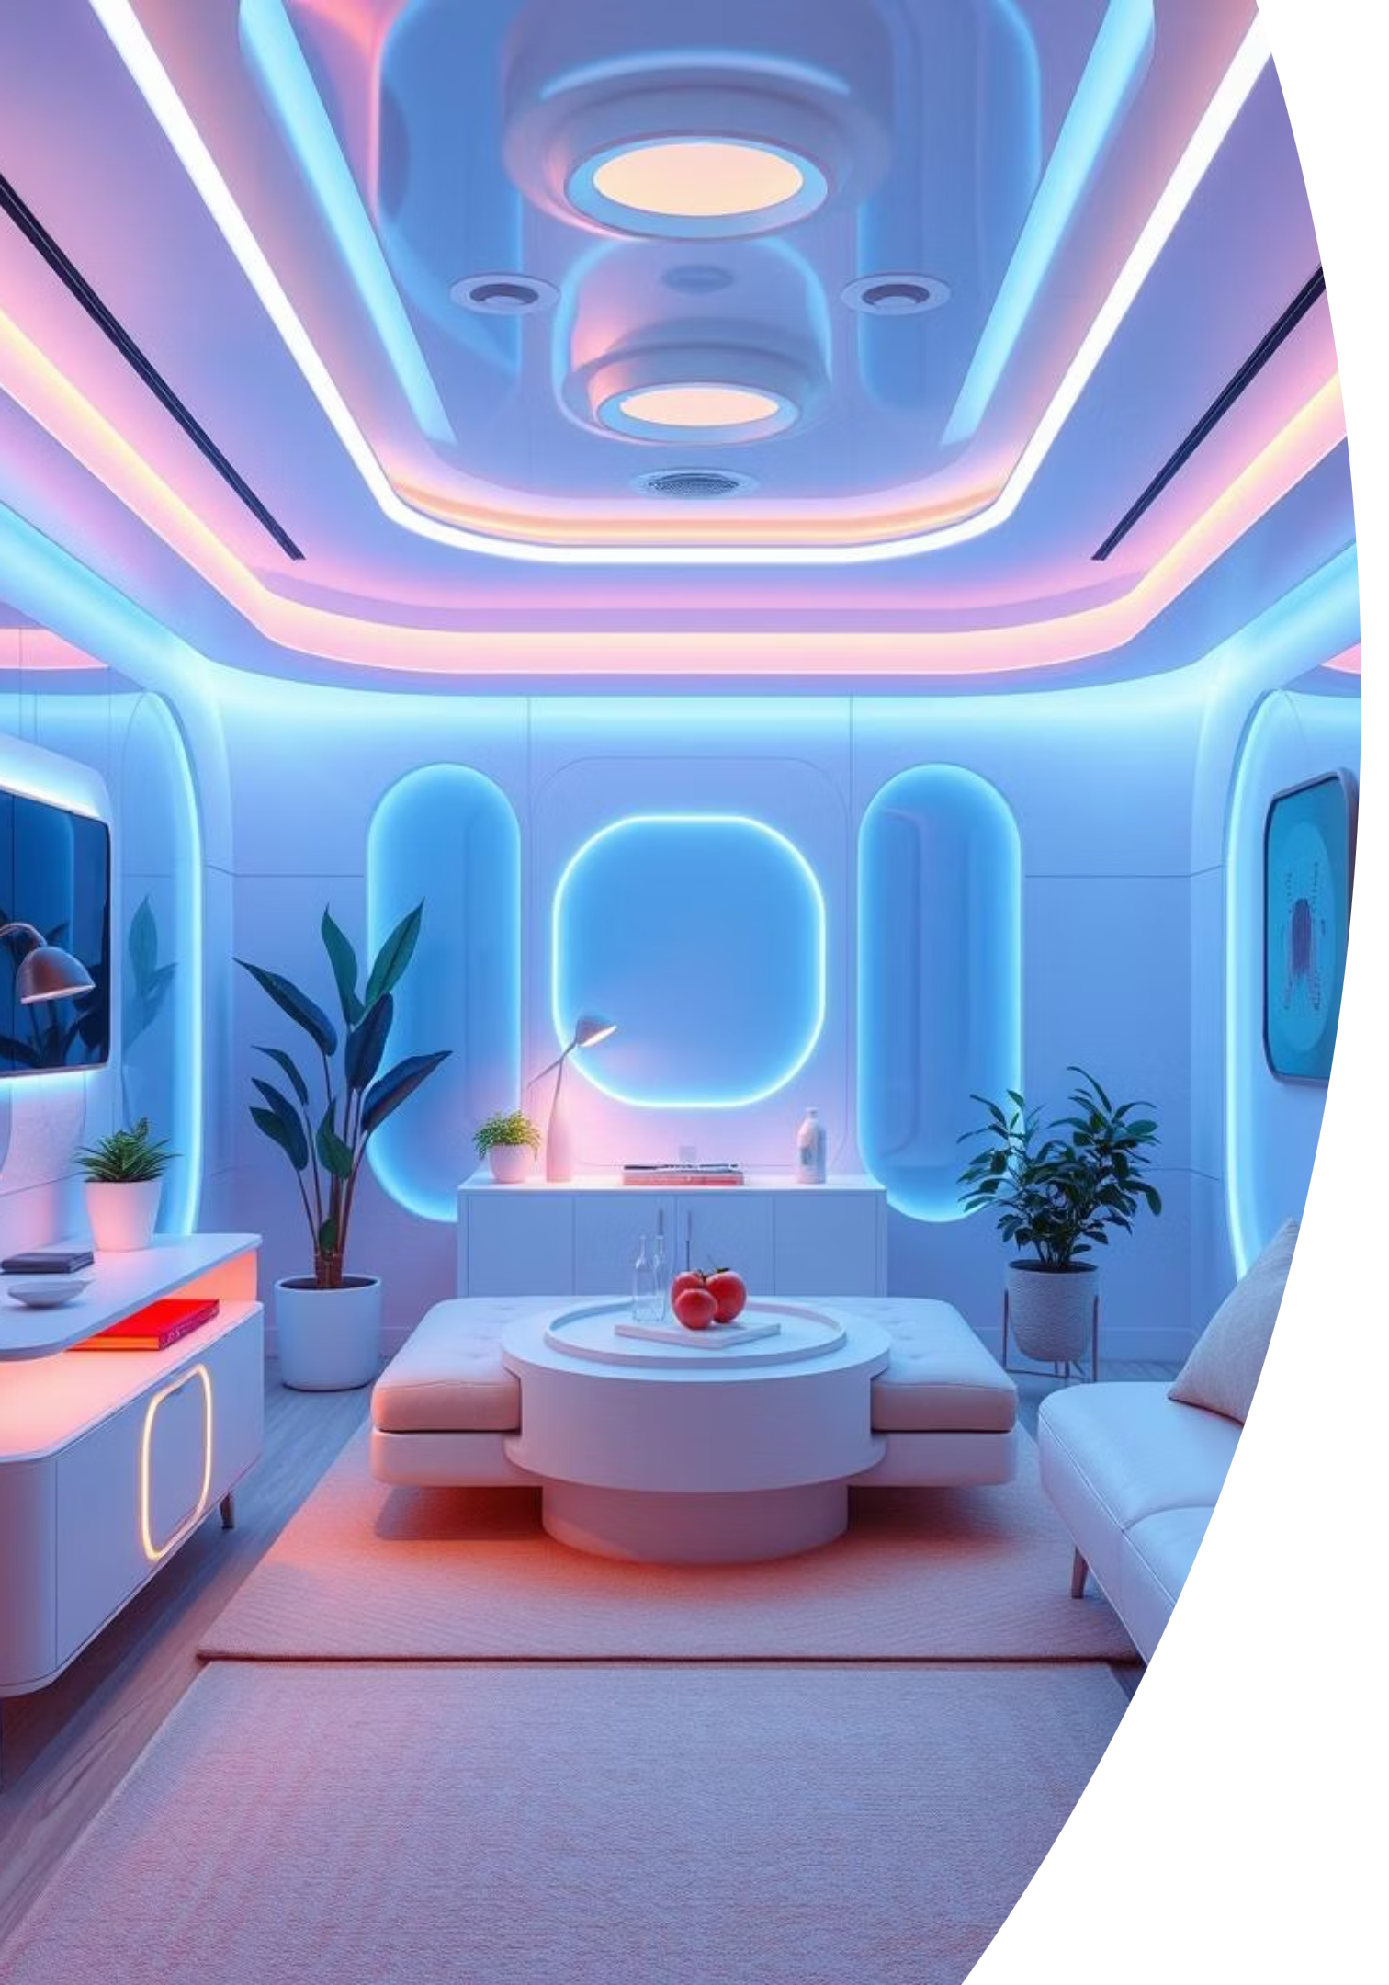
Future Scope & Vision for Ohmies
The initial release of Ohmies is just the beginning. Our vision extends far beyond basic posture correction. We plan to integrate AI and machine learning algorithms to provide even more personalized feedback, predicting potential posture issues before they become severe.
Future iterations may include smart material integration for a more seamless, fabric-based wearable, and integration with other smart health platforms. We aim to develop a subscription model for premium features, such as live posture coaching, advanced analytics, and custom exercise routines from certified physical therapists, solidifying Ohmies as a leader in proactive health management.

